Slide 1

PH-ATM
CIVIL AVIATION AUTHORITY OF THE PHILIPPINES
AIR NAVIGATION SERVICE
Title
Module 02
AISS Hardware Components
Objective:
Identify the PHATM AISS Hardware Components Using the GSSDD, HCMD, SIF, and Solution Description Documents.
AISS System

Slide 2
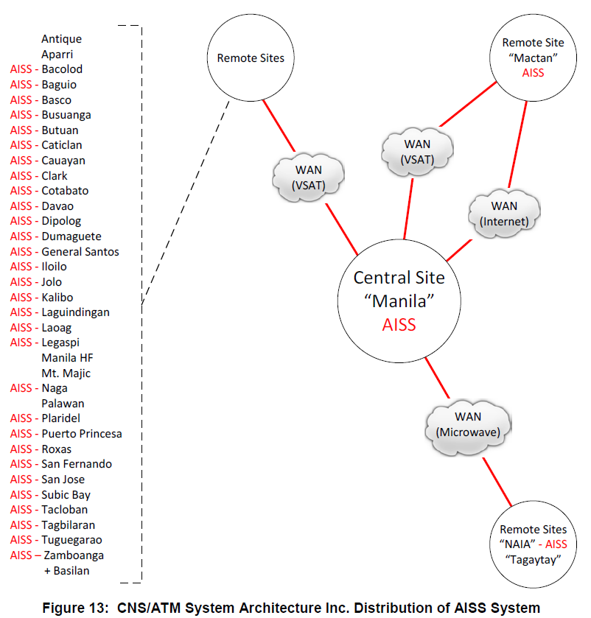
Distribution of AISS System
Title
AISS System
Notes:
PHATM DOC.VOL1.BOOK3.P74
GSSDD – Global System/Segment Design Document
AISS System is a computer system with hardware components distributed nationwide.
The Central Site is located here in Manila. The operational servers are installed at Manila ATMC while the failover servers at the Mactan ANF. Data from the operational servers are being replicated to the failover servers via the internet and vsat link.
Hosts (client and working positions) within the central site are connected via LAN while remote hosts are connected to the central site via WAN (microwave, vsat, internet).
As with other computer systems, the AISS Hardware implementation is composed of: (next slide)

Slide 3
AISS Hardware Components
Title
Servers
KVM Consoles & KVM Switches
Storage & Backup Devices
Network Appliance
Workstations
Display Devices
Printers & Plotters
Computer Peripherals
AISS System
Notes:
smartAIM Solution Description
Appendix A: AIS System - Hardware Item List
Reference to the documents:
• Attach_A_PH-ATM PK1_AISS_RFA_List_RevF.xsl
• P1ES-EI-14-002.pdf
Hardware Configuration Management Document

Slide 4
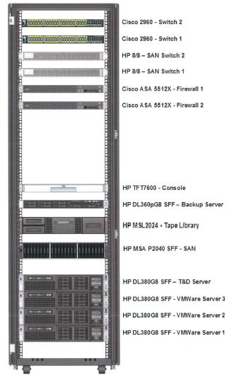
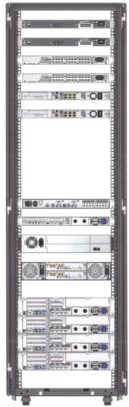
Central Site – Manila ATMC
Title
Front View Rear View
AISS Rack
AISS System
Notes:
PHATM DOC.VOL1.BOOK1 – Site Installation File (Manila ATM Centre)
AISS Rack is located at Communications Equipment Room – First Floor.
AISS Rack – 42 Unit
Major hardware components are being

Slide 5
Central Site – Manila ATMC
Title
AISS Rack
Cabinet:
Manufacturer:
Type:
Height:
Units:
Width:
Depth:
Frame Material:
Side covers:
Doors:
Housing color:
Fittings color:
AISS System
Notes:
PHATM DOC.VOL1.BOOK2 – Hardware Configuration Management Document (Manila ATM Centre)
AISS Rack is located at Communications Equipment Room – First Floor.
AISS Rack – 42 Unit

Slide 6
Central Site – Manila ATMC
Title
AISS Rack
Servers:
3 Operational Servers:
HP ProLiant DL380p Gen8 SFF
Node Names: (MAN-ESX-01, 02 & 03)
1 T&D Server:
HP ProLiant DL380p Gen8 SFF
Node Name: (MAN-ESX-04)
AISS System
Notes:
Equipment Name / Node Name

Slide 7
Central Site – Manila ATMC
Title
AISS Rack
Storage Devices:
1 SAN Storage
HP MSA P2040 SFF SAN Storage
(MAN-STO-01)
2 SAN Switches
HP 8/8 (8)-Ports Enabled SAN Switch
(MAN-SSW-01 & 02)
AISS System
Notes:
Which data are being stored?
8GB Fibre Channel SAN Switch

Slide 8
Central Site – Manila ATMC
Title
AISS Rack
Backup Devices:
1 Backup Server:
HP ProLiant DL360p Gen8 SFF
Node Name: (MAN-BCK-01)
1 Tape Library
HP MSL2024 1 LTO-4 Ultrium 1840 FC TP Lib
(MAN-TAP-01)
AISS System
Notes:
Which data are being backed up?
Verify Tape Library if Fibre Channel or SAS?

Slide 9
Central Site – Manila ATMC
Title
AISS Rack
KVM Console:
1 Rackmount KVM Console
HP TFT7600 US G2, All-in-One Rack Konsole
(MAN-CON-01)
KVM Switch:
1 Rackmount KVM Switch
HP 0x2x8 KVM Switch
(MAN-KVM-01)
AISS System

Slide 10
Central Site – Manila ATMC
Title
AISS Rack
Network Appliance:
2 Cisco Switches
Cisco Catalyst WS-C2960G-48TC-L Switch
(MAN-SWI-01 & 02)
2 Cisco Firewalls
Cisco ASA 5512X Security Plus Firewall
(MAN-FWF-01 & 02)
AISS System

Slide 11
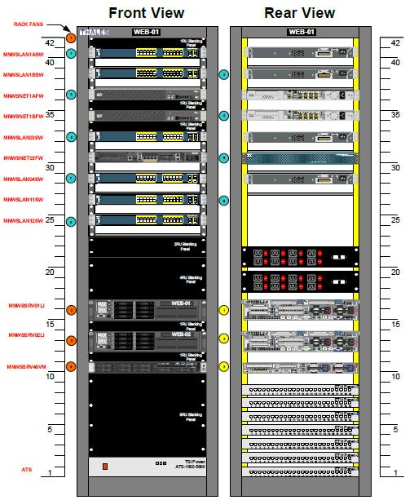
Central Site – Manila ATMC
Title
WEB 01 Rack
AISS System
Notes:
PHATM DOC.VOL1.BOOK1 – Site Installation File (Manila ATM Centre)
WEB 01 Rack is located at Communications Equipment Room – First Floor.
MNWSLAN03SW – VPN Support

Slide 12
Central Site – Manila ATMC
Title
WEB 01 Rack
Network Appliance:
1 Cisco Switch for Support
Cisco Catalyst 2960 24X
(MNWSLAN03SW)
AISS System
Notes:
PHATM DOC.VOL1.BOOK2 – Hardware Configuration Management Document (Manila ATM Centre)
WEB 01 Rack is located at Communications Equipment Room – First Floor.
MNWSLAN03SW – VPN Support

Slide 13
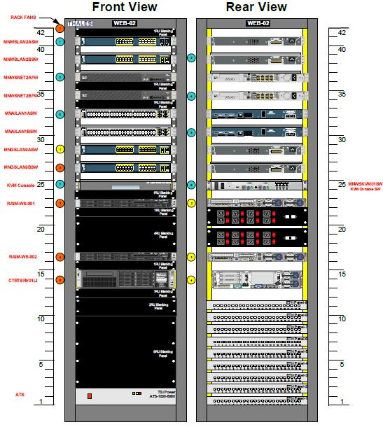
Central Site – Manila ATMC
Title
WEB 02 Rack
AISS System
Notes:
PHATM DOC.VOL1.BOOK1 – Site Installation File (Manila ATM Centre)
WEB 02 Rack is located at Communications Equipment Room – First Floor.
ATMC Client Switch (except TEC Client) - MNAILAN1ASW ( AISS A) & MNAILAN1BSW (AISS B)
DMZ - MNWSLAN2ASW & MNWSLAN2BSW

Slide 14
Central Site – Manila ATMC
Title
WEB 02 Rack
Network Appliance:
2 Cisco Switches for Central Site Clients
Cisco Catalyst 3750G 48X 10/100/1000 /4SFP Standard Multilayer Image
(MNAILAN1ASW & MNAILAN1BSW)
2 Cisco Switches for DMZ
Cisco Catalyst 2960 24X
(MNWSLAN2ASW & MNWSLAN2BSW)
AISS System
Notes:
PHATM DOC.VOL1.BOOK2 – Hardware Configuration Management Document (Manila ATM Centre)
WEB 02 Rack is located at Communications Equipment Room – First Floor.
ATMC Client Switch (except TEC Client) - MNAILAN1ASW ( AISS A) & MNAILAN1BSW (AISS B)
DMZ - MNWSLAN2ASW & MNWSLAN2BSW
The small form-factor pluggable (SFP) is a compact, hot-pluggable
optical module transceiver used for both telecommunication and data
communications applications. The form factor and electrical interface are
specified by a multi-source agreement (MSA) under the auspices of the
Small Form Factor Committee.[1] It is a popular industry format jointly
developed and supported by many network component vendors.

Slide 15
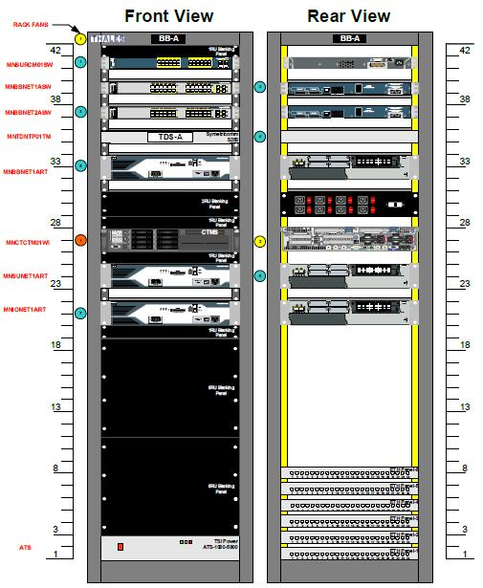
Central Site – Manila ATMC
Title
BackBone-A Rack
AISS System
Notes:
PHATM DOC.VOL1.BOOK1 – Site Installation File (Manila ATM Centre)
BackBone Rack is located at Communications Equipment Room – First Floor.
MNBBNET1ART (Rack A)

Slide 16
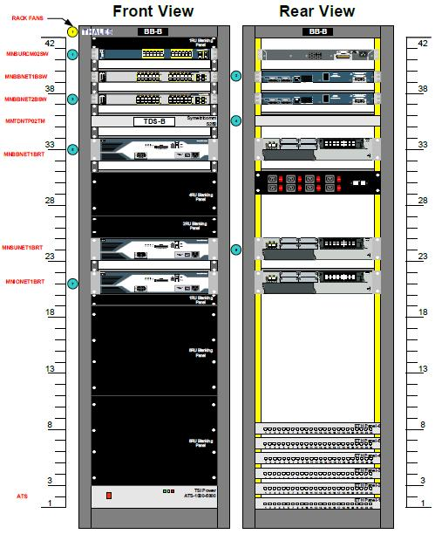
Central Site – Manila ATMC
Title
BackBone-B Rack
AISS System
Notes:
PHATM DOC.VOL1.BOOK1 – Site Installation File (Manila ATM Centre)
BackBone Rack is located at Communications Equipment Room – First Floor.
MNBBNET1BRT (Rack B)

Slide 17
Central Site – Manila ATMC
Title
BackBone Rack
Network Appliance:
2 Cisco Routers
Cisco Catalyst 2821 16X
(MNBBNET1ART & MNBBNET1BRT)
AISS System
Notes:
PHATM DOC.VOL1.BOOK2 – Hardware Configuration Management Document (Manila ATM Centre)
BackBone Rack is located at Communications Equipment Room – First Floor.
Backbone Routers
MNBBNET1ART (Rack A)
MNBBNET1BRT (Rack B)

Slide 18
Central Site – Manila ATMC
Title
Communication Equipment Room
AIS Technical Workstation:
1 AISS LAN Control Workstation
HP Z230 Tower Workstation
HP Z22I 21.5-Inch IPS Monitor
Node Name: (MAN-TEC-01)
AIS Printer:
1 HP OfficeJet7110 Wide Format ePrinter
AISS System
Notes:
PHATM DOC.VOL1.BOOK2 – Hardware Configuration Management Document (Manila ATM Centre)
MAN-TEC-01 (CWP 72 / AIS Control) & MAN-PRN-13 – Located at Communications Equipment Room, First Floor

Slide 19
Central Site – Manila ATMC
Title
AIS Room
AIS Workstations:
4 AIS Workstations w/ AMHS UA
HP Z230 Tower Workstation
HP Z22I 21.5-Inch IPS Monitor
Node Names: (MAN-WKS-04, 05, 14 & 15)
2 Map/Charting Workstations
HP Z230 Tower Workstation
HP Z30I 30-Inch IPS Monitor
HP Z22I 21.5-Inch IPS Monitor
GTCO CalComp A1 Tablet Digitizer, Drawing Board VI – 2436
Node Names: (MAN-WKS-12 & 13)
AISS System
Notes:
PHATM DOC.VOL1.BOOK2 – Hardware Configuration Management Document (Manila ATM Centre)
CWP 51 / AIS 01 / MAN-WKS-14
CWP 54 / AIS 02 / MAN-WKS-04
CWP 61 / AIS 03 / MAN-WKS-05
CWP 60 / AIS 04 / MAN-WKS-15
CWP 52 / MAP-01 / MAN-WKS-12
CWP 56 / MAP-02 / MAN-WKS-13

Slide 20
Central Site – Manila ATMC
Title
AIS Room
AIS Workstations:
2 eAIP Workstations
HP Z230 Tower Workstation
HP Z30I 30-Inch IPS Monitor
HP Z22I 21.5-Inch IPS Monitor
Node Names: (MAN-WKS-10 & 11)
AISS System
Notes:
PHATM DOC.VOL1.BOOK2 – Hardware Configuration Management Document (Manila ATM Centre)
CWP 53 / AIP-01 / MAN-WKS-10
CWP 57 / AIP-02 / MAN-WKS-11

Slide 21
Central Site – Manila ATMC
Title
AIS Room
AIS Printers:
3 HP OfficeJet7110 Wide Format ePrinter
2 Brother MFC-J5910DW MFP A3 Color Ink Print Scan
AIS Plotters:
2 HP DesignJet T2500 e-Multifunction Printer
AISS System
Notes:
PHATM DOC.VOL1.BOOK2 – Hardware Configuration Management Document (Manila ATM Centre)
HP OfficeJet7110 Wide Format ePrinter
CWP 51 MAP-01 MAN-PRN-14
CWP 54 AIS-03 MAN-PRN-04
CWP 60 AIS-04 MAN-PRN-14
Brother MFC-J5910DW MFP A3 Color Ink Print Scan
CWP 52 MAP-01?AIP01 MAN-PRN-11
CWP 56 MAP-02 MAN-PRN-12
HP DesignJet T2500 e-Multifunction Printer
AIS Plotter 1 MAP-1 MAN-PLT-01
AIS Plotter 2 MAP-2 MAN-PLT-02

Slide 22
Manila ATMC AIS Room Workstations (Other Subsystems)
1 CADAS User Agent Position Workstation (CADAS-UA 2)
HP Comp ProDesk 600 G1 SSF - Intel i5 4570 3.2GHz
HP Elite Display E231
2 GSMS Workstations (RAIM-MO-001 & 002)
NEC Express5800/53La – Intel Pentium Processor G6950 (2.80GHz)
24 inch Widescreen LCD Monitor
1 MDPS Supervision Workstation (MDPS-01)
HP Z400 Workstation - Intel 3550 3.0Ghz
HP 24" Compaq Monitor
1 ADEW Workstation (MNAWWKS01WI)
HP Z400 Workstation - Intel Xeon 3520 2.66 GHz
Barco MDRC 2224 24" Monitor
Gorgy LEDI 2/S Console Clock NTP 10/100BaseT
AISS System
Notes:
PHATM DOC.VOL1.BOOK2 – Hardware Configuration Management Document (Manila ATM Centre)
AMHS Subsystem
CWP 55 / AIDA-Ph-II Manila CADAS-UA 2 / CADAS-UA 2
GSMS Subsystem
CWP 58 / RAIM-MO-001 / --
CWP 59 / RAIM-MO-002 / --
MDPS Subsytem
CWP 62 / MDPS-01 / --
ADEW Subsystem
CWP 63 / ADEW-1 / MNAWWKS01WI (ODS7)

Slide 23
Manila ATMC AIS Room Printers and Plotters (Other Subsystems)
Printers
1 HP LaserJet Pro 400 M401D 33ppm S7W, Duplex 1200dpi
1 HP Color LaserJet CP5525dn Printer
1 HP CP5525dn A3 LaserJet Colour Printer
Plotters
1 HP DesignJet Z6200 A1 Plotter
AISS System
Notes:
PHATM DOC.VOL1.BOOK2 – Hardware Configuration Management Document (Manila ATM Centre)
AMHS Subsystem
HP LaserJet Pro 400 M401D 33ppm S7W, Duplex 1200dpi
GSMS Subsystem
HP Color LaserJet CP5525dn Printer
MDPS Subsytem
HP CP5525dn A3 LaserJet Colour Printer
ADEW Subsystem
HP DesignJet Z6200 A1 Plotter

Slide 24
Central Site – Manila ATMC
Title
RCC Room
AIS Workstation:
1 AIS Workstation
HP Z230 Tower Workstation
HP Z30I 30-Inch IPS Monitor
HP Z22I 21.5-Inch IPS Monitor
Node Name: (MAN-WKS-07)
AIS Printer:
1 HP OfficeJet7110 Wide Format ePrinter
AISS System
Notes:
PHATM DOC.VOL1.BOOK2 – Hardware Configuration Management Document (Manila ATM Centre)
CWP 99 AIS-1 MAN-WKS-07
CWP 99 AIS-1 MAN-PRN-08

Slide 25
Central Site – Manila ATMC
Title
FIS Room
AIS Workstations:
1 AMS Monitoring Workstation
HP Z230 Tower Workstation
HP Z22I 21.5-Inch IPS Monitor
Node Name: (MAN-WKS-09)
1 FSS Monitoring Workstation
HP Z230 Tower Workstation
HP Z22I 21.5-Inch IPS Monitor
Node Name: (MAN-WKS-08)
AIS Printers:
2 HP OfficeJet7110 Wide Format ePrinter
AISS System
Notes:
PHATM DOC.VOL1.BOOK2 – Hardware Configuration Management Document (Manila ATM Centre)
AMS
CWP 128 AIS/AMHS MAN-WKS-09
CWP 128 AIS/AMHS MAN-PRN-10
FSS
CWP 125 AIS/AMHS MAN-WKS-08
CWP 125 AIS/AMHS MAN-PRN-09

Slide 26
Central Site – Manila ATMC
Title
ATM Operations Room
AIS Workstations:
3 AIS/AMHS Workstations
HP Z230 Tower Workstation
HP Z22I 21.5-Inch IPS Monitor
Node Names: (MAN-WKS-01, 02 & 03)
AIS Printers:
3 HP OfficeJet7110 Wide Format ePrinter
AISS System
Notes:
PHATM DOC.VOL1.BOOK2 – Hardware Configuration Management Document (Manila ATM Centre)
CWP-35 AIS/AMHS-1 MAN-WKS-02
CWP-35 AIS/AMHS-1 MAN-PRN-02
CWP-39 AIS/AMHS-2 MAN-WKS-03
CWP-39 AIS/AMHS-2 MAN-PRN-03
CWP-47 AIS-1 MAN-WKS-01
CWP-47 AIS-1 MAN-PRN-01

Slide 27
Central Site – Manila ATMC
Title
Briefing Room
AIS Workstation:
1 AIS/AMHS Workstations
HP Z230 Tower Workstation
HP Z22I 21.5-Inch IPS Monitor
Node Name: (MAN-WKS-06)
AIS Printer:
1 HP OfficeJet7110 Wide Format ePrinter
AISS System
Notes:
PHATM DOC.VOL1.BOOK2 – Hardware Configuration Management Document (Manila ATM Centre)
CWP-69 AIS MAN-WKS-06
CWP-70 AIS MAN-PRN-07

Slide 28
Central Site – CAAP HQ
Title
ANS Central Office
AIS Workstation:
1 AIS/AMHS Workstations
HP Z230 Tower Workstation
HP Z22I 21.5-Inch IPS Monitor
AIS Printer:
1 HP OfficeJet7110 Wide Format ePrinter
AISS System
Notes:
PHATM DOC.VOL1.BOOK2 – Hardware Configuration Management Document (Manila ATM Centre)

Slide 29
Central Site – CAAP HQ
Title
Operations Center (OPCEN)
AIS Workstation:
1 AIS/AMHS Workstations
HP Z230 Tower Workstation
HP Z22I 21.5-Inch IPS Monitor
AIS Printer:
1 HP OfficeJet7110 Wide Format ePrinter
AISS System
Notes:
PHATM DOC.VOL1.BOOK2 – Hardware Configuration Management Document (Manila ATM Centre)

Slide 30
Central Site – CAAP HQ
Title
ATC Central Office
AIS Workstation:
1 AIS/AMHS Workstations
HP Z230 Tower Workstation
HP Z22I 21.5-Inch IPS Monitor
AIS Printer:
1 HP OfficeJet7110 Wide Format ePrinter
AISS System
Notes:
PHATM DOC.VOL1.BOOK2 – Hardware Configuration Management Document (Manila ATM Centre)

Slide 31
Remote Sites – via Microwave Link
Title
NAIA ANF
AIS Workstations:
AIS/AMHS Workstations
HP Z230 Tower Workstation
HP Z22I 21.5-Inch IPS Monitor
AIS Printer:
HP OfficeJet7110 Wide Format ePrinter
AISS System
Notes:
NAIA Tower
Verify if 2 workstations. NAIA Tower and (NAIA FSS instead of Tagaytay ANF).
Verify if Tagaytay ANF workstation exists.

Slide 32
Remote Sites – via Microwave Link
Title
Tagaytay ANF
AIS Workstations:
AIS/AMHS Workstations
HP Z230 Tower Workstation
HP Z22I 21.5-Inch IPS Monitor
AIS Printer:
HP OfficeJet7110 Wide Format ePrinter
AISS System
Notes:
Inconsistent
HCMD – Tagaytay
SIF Port – NAIA
SOD – NAIA FSS
Verify if Tagaytay ANF workstation exists.

Slide 33
Remote Sites – via VSAT
Title
Nationwide Remote Sites
AIS Workstations:
AIS/AMHS Workstations
HP Z230 Tower Workstation
HP Z22I 21.5-Inch IPS Monitor
AIS Printer:
HP OfficeJet7110 Wide Format ePrinter
AISS System

Slide 34
Failover Site – Mactan ANF
Title
Refer to Mactan ANF Documents:
Hardware Configuration Management Document
Global System/Segment Document
Site Installation File
AISS System
Notes:
Proceed on ATMC Facility Tour.

Slide 35
Hardware Interconnections
Title
Refer to PHATM Documents:
Hardware Configuration Management Document
Global System/Segment Document
Site Installation File
SmartAIM Solution Description
Use updated copies of such documents.
AISS System
Notes:
AISS to ATMC Back Bone
AISS to DMZ
AISS to Support
Port Allocations
Inconsistencies (AISS)
CPRTLAN01SW (BackboneDiagram) vs CPAILAN01SW01 (MNAILAN1ASW PortAllocation)
CPRTLAN01SW has no PortAllocation Diagram, secure updated copy..
Update MNAILAN(1A & 1B)SW PortAllocation
Verify if AIS workstations and working positions are connected to MNAILAN1ASW or CAAP Switch?
Verify location of CAAP Switch?

Slide 36
Facility Tour…

Slide 37
Facility Tour – AISS System
Title
Manila ATMC Building
Communications Equipment Room
AIS Room
RCC Room
FIS Room
Operations Room
Briefing Room
Back To AISS Rack
AISS System
Notes:
Need keys for abovementioned rooms.
Need keys for AIS Rack, Backbone Rack A&B, and Web02 Rack.

Slide 38
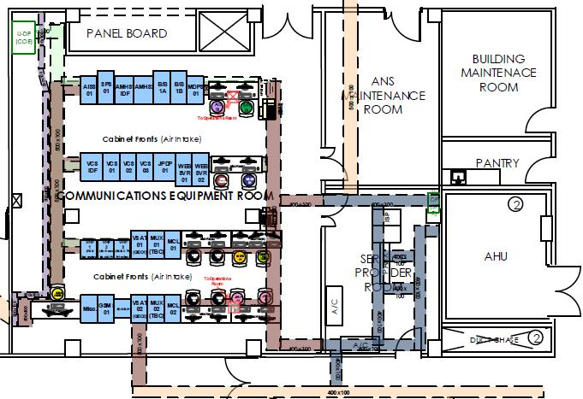
Communications Equipment Room
Title
Back To AISS Rack
AISS System
Notes:
AISS LAN Control Workstation
CWP 72 / AIS Control / MAN-TEC-01
MAN-PRN-13
WEB 02 Rack
MNAILAN1ASW (AISS A)
MNAILAN1BSW (AISS B)
AISS Rack

Slide 39
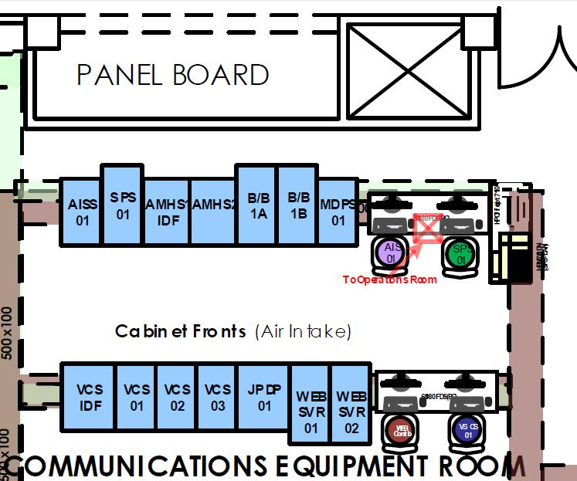
Communications Equipment Room
Title
Back To AISS Rack
AISS System
Notes:
Request for access information: e.g. Username/Password for OS and applications.
MAN-TEC-01 (CWP 72 / AIS Control) & MAN-PRN-13 – AKA AISS LAN Control Workstation
AISS Rack
WEB 02 Rack - MNAILAN1ASW ( AISS A) & MNAILAN1BSW (AISS B)

Slide 40
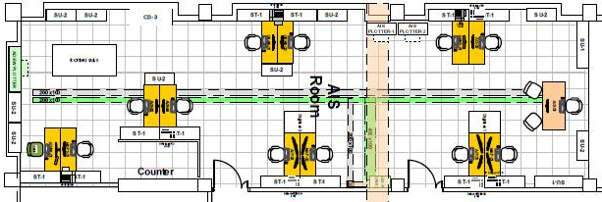
AIS Room
Title
Back To AISS Rack
AISS System
Notes:
4 AIS Workstations
CWP 51 / AIS 01 / MAN-WKS-14
CWP 54 / AIS 02 / MAN-WKS-04
CWP 61 / AIS 03 / MAN-WKS-05
CWP 60 / AIS 04 / MAN-WKS-15
2 eAIP Workstations
CWP 53 / AIP-01 / MAN-WKS-10
CWP 57 / AIP-02 / MAN-WKS-11
2 Map/Charting Workstations
CWP 52 / MAP-01 / MAN-WKS-12
CWP 56 / MAP-02 / MAN-WKS-13
3 HP OfficeJet 7110 Printers
CWP 51 MAP-01 MAN-PRN-14
CWP 54 AIS-03 MAN-PRN-04
CWP 60 AIS-04 MAN-PRN-14
2 Brother MFC-J5910DW Printers
CWP 52 MAP-01?AIP01 MAN-PRN-11
CWP 56 MAP-02 MAN-PRN-12
2 HP DesignJet T2500 Plotters
AIS Plotter 1 MAP-1 MAN-PLT-01
AIS Plotter 2 MAP-2 MAN-PLT-02

Slide 41
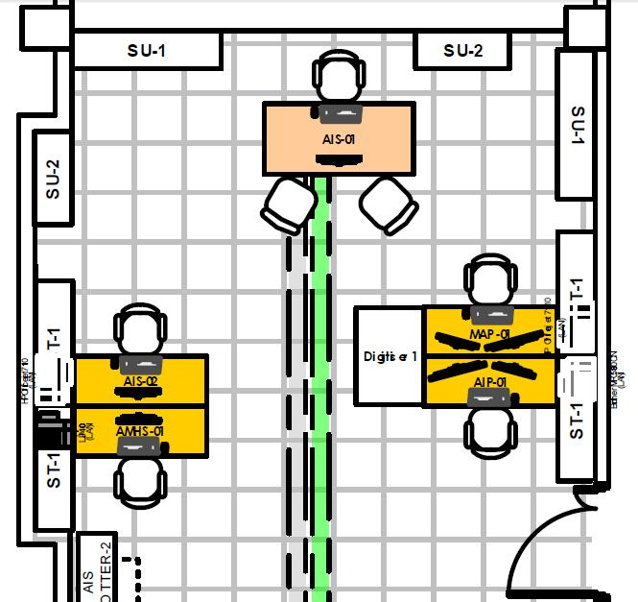
AIS Room
Title
Back To AISS Rack
AISS System
Notes:
Right Wing

Slide 42
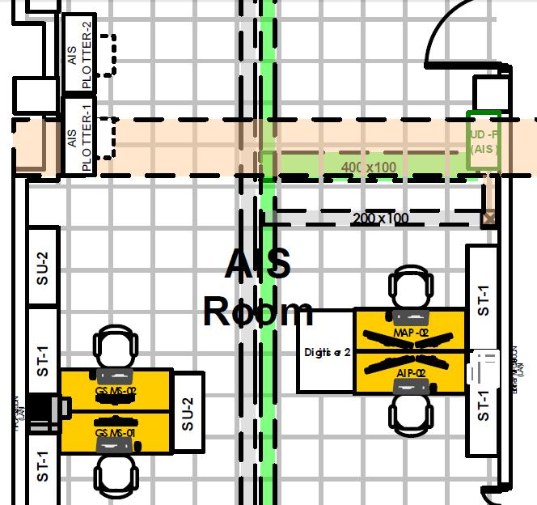
AIS Room
Title
Back To AISS Rack
AISS System
Notes:
Center

Slide 43
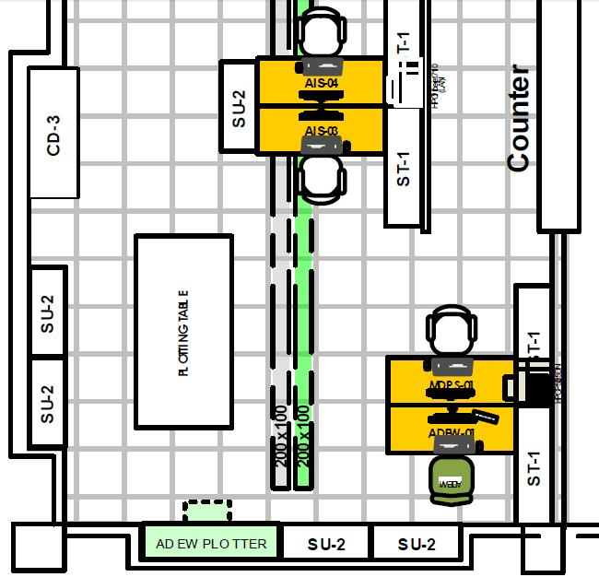
AIS Room
Title
Back To AISS Rack
AISS System
Notes:
Left Wing

Slide 44
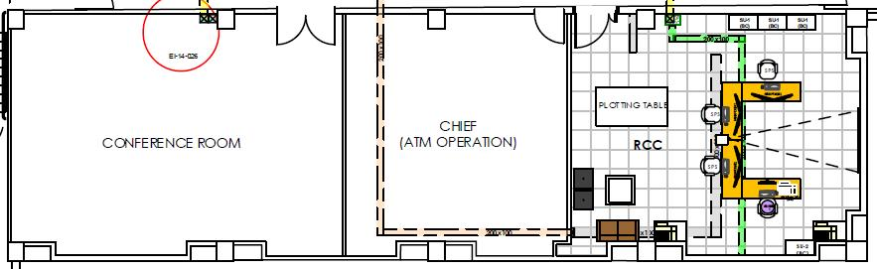
RCC Room
Title
Back To AISS Rack
AISS System
Notes:
Verify if AIS Working Position or AIS/AMHS Workstation.
CWP 99 AIS-1 MAN-WKS-07
CWP 99 AIS-1 MAN-PRN-08

Slide 45
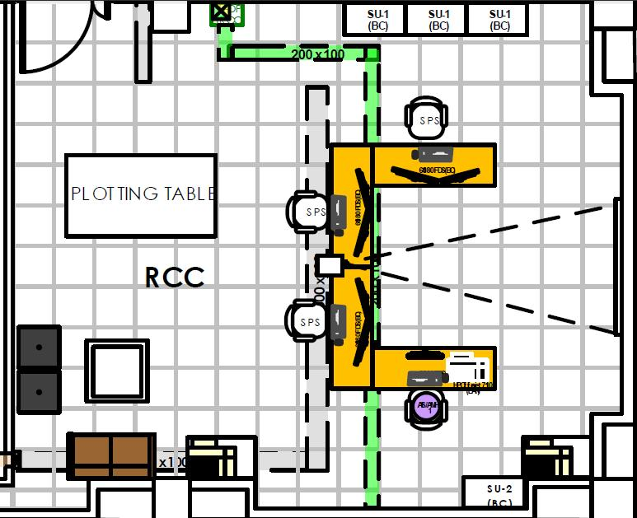
RCC Room
Title
Back To AISS Rack
AISS System

Slide 46
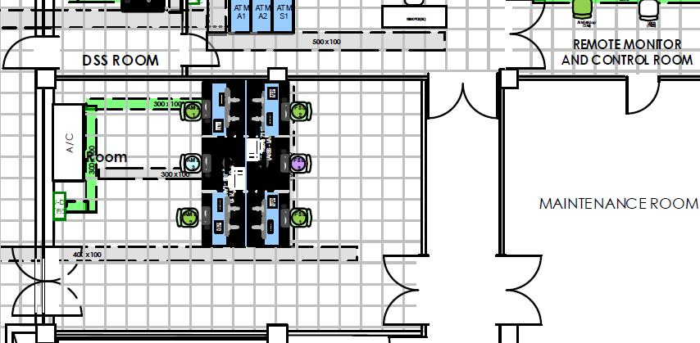
FIS Room
Title
Back To AISS Rack
AISS System
Notes:
AMS
CWP 128 AIS/AMHS MAN-WKS-09
CWP 128 AIS/AMHS MAN-PRN-10
FSS
CWP 125 AIS/AMHS MAN-WKS-08
CWP 125 AIS/AMHS MAN-PRN-09

Slide 47
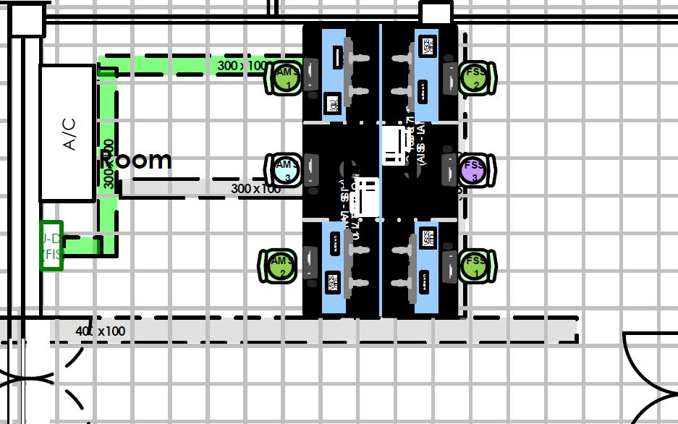
FIS Room
Title
Back To AISS Rack
AISS System
Notes:
AMS
CWP 128 AIS/AMHS MAN-WKS-09
CWP 128 AIS/AMHS MAN-PRN-10
FSS
CWP 125 AIS/AMHS MAN-WKS-08
CWP 125 AIS/AMHS MAN-PRN-09

Slide 48
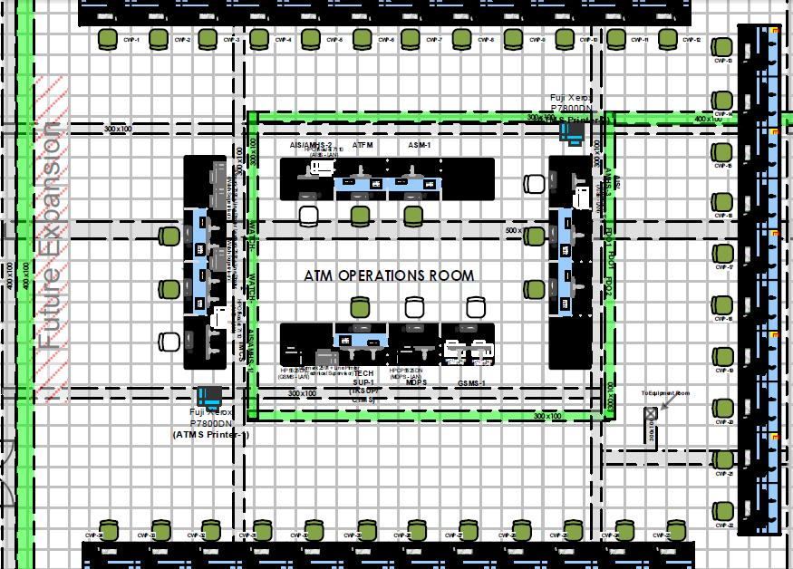
ATM Operations Room
Title
Back To AISS Rack
AISS System
Notes:
CWP-35 AIS/AMHS-1 MAN-WKS-02
CWP-35 AIS/AMHS-1 MAN-PRN-02
CWP-39 AIS/AMHS-2 MAN-WKS-03
CWP-39 AIS/AMHS-2 MAN-PRN-03
Verify Equipment/Node Name
CWP-47 AIS-1 MAN-WKS-01
CWP-47 AIS-1 MAN-PRN-01

Slide 49
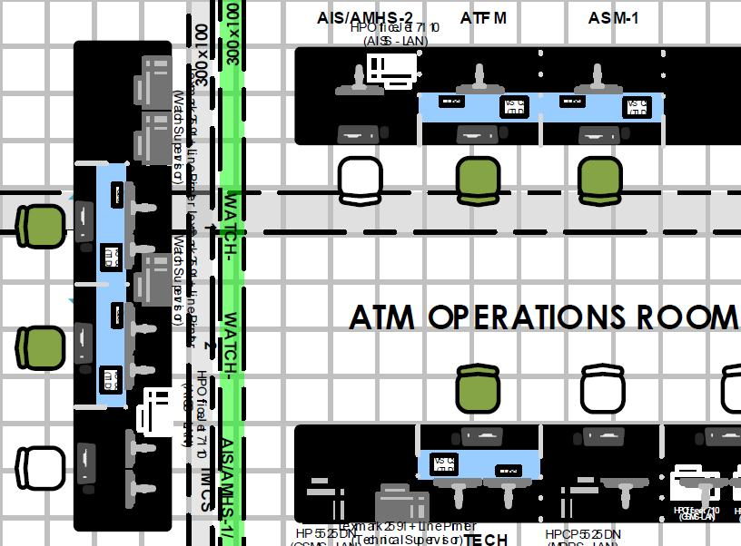
ATM Operations Room
Title
Back To AISS Rack
AISS System
Notes:
CWP-35 AIS/AMHS-1 MAN-WKS-02
CWP-35 AIS/AMHS-1 MAN-PRN-02
CWP-39 AIS/AMHS-2 MAN-WKS-03
CWP-39 AIS/AMHS-2 MAN-PRN-03
Verify Equipment/Node Name
CWP-47 AIS-1 MAN-WKS-01
CWP-47 AIS-1 MAN-PRN-01

Slide 50
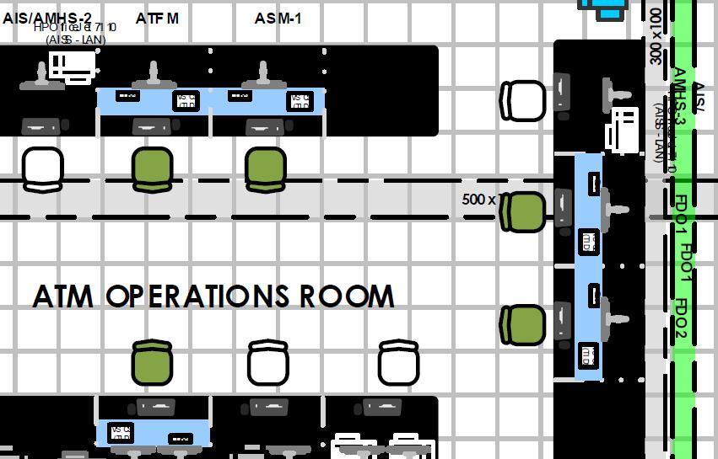
ATM Operations Room
Title
Back To AISS Rack
AISS System
Notes:
CWP-35 AIS/AMHS-1 MAN-WKS-02
CWP-35 AIS/AMHS-1 MAN-PRN-02
CWP-39 AIS/AMHS-2 MAN-WKS-03
CWP-39 AIS/AMHS-2 MAN-PRN-03
Verify Equipment/Node Name
CWP-47 AIS-1 MAN-WKS-01
CWP-47 AIS-1 MAN-PRN-01

Slide 51
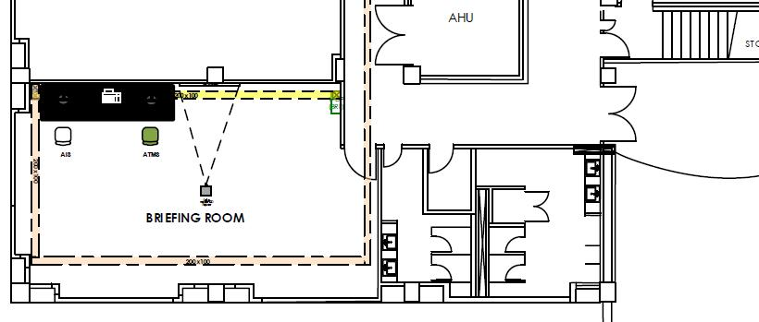
Briefing Room
Title
Back To AISS Rack
AISS System
Notes:
CWP-69 AIS MAN-WKS-06
CWP-70 AIS MAN-PRN-07

Slide 52
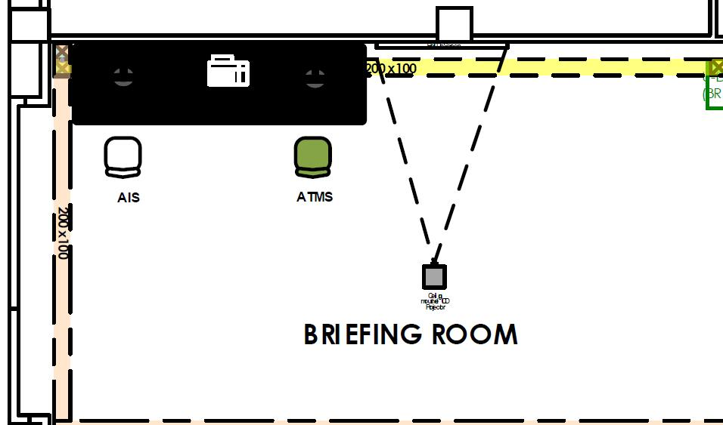
Briefing Room
Title
Back To AISS Rack
AISS System
Notes:
CWP-69 AIS MAN-WKS-06
CWP-70 AIS MAN-PRN-07

Slide 54
Preventive Maintenance
Title
Perform periodic system status check through local and central monitoring systems (Zabbix and WUG-CTMS) and then take appropriate actions if necessary.
Perform the recommended practices based on the AISS Maintenance Manual and Hardware Documentations.
Within Warranty Contract:
Request guidance from Thales Engineers if necessary.
AISS System
Notes:
Cleaning
Handling
Storage
Spare Parts Periodic Check
e.g. Clarifications re procedures.

Slide 55
Corrective Maintenance
Title
Within Warranty Contract:
Perform corrective actions as stipulated in the warranty contract.
Beyond Warranty Contract:
Perform the recommended corrective actions based on the AISS Maintenance Manual and other relevant hardware documents available.
AISS System
Notes:
PCRs

Slide 56
SUMMARY
Title
In this module, the AISS Hardware Components and their corresponding locations were identified:
Servers
Consoles & KVMs
Storage & Backup Devices
Network Appliance
Workstations
Display Devices
Printers & Plotters
Computer Peripherals
AISS System

Slide 57
SUMMARY
Title
Operational & T&D Servers:
HP ProLiant DL380p Gen8 SFF
Console:
HP TFT7600 US G2, All-in-One Rack Konsole
KVM:
HP 0x2x8 KVM Server Console Switch
AISS System

Slide 58
SUMMARY
Title
Storage Devices:
HP MSA P2040 SFF SAN Controller
HP 8/8 (8)-Ports Enabled SAN Switch
Backup Devices:
HP ProLiant DL360p Gen8 SFF
HP MSL2024 Tape Library & LTO Ultrium Tape
AISS System

Slide 59
SUMMARY
Title
Workstations:
HP Z230 Tower Workstations
Display:
HP Z30I 30-Inch IPS Monitor
HP Z22I 21.5-Inch IPS Monitor
Network Appliance:
Cisco ASA 5512X Security Plus Firewall
Cisco Catalyst 3750G 48X 10/100/1000 /4SFP
Cisco Catalyst WS-C2960G-48TC-L Switch
Cisco Catalyst 2821 16x Router
AISS System

Slide 60
SUMMARY
Title
Printers:
HP OfficeJet7110 Wide Format ePrinter
Brother MFC-J5910DW MFP A3 Color Ink Print Scan
Plotters:
HP DesignJet T2500 e-Multifunction Printer
Peripherals:
Mouse
Keyboard
GTCO CalComp A1 Tablet Digitizer, Drawing Board
UPS
AISS System

Slide 61

End..
Title

Slide 63
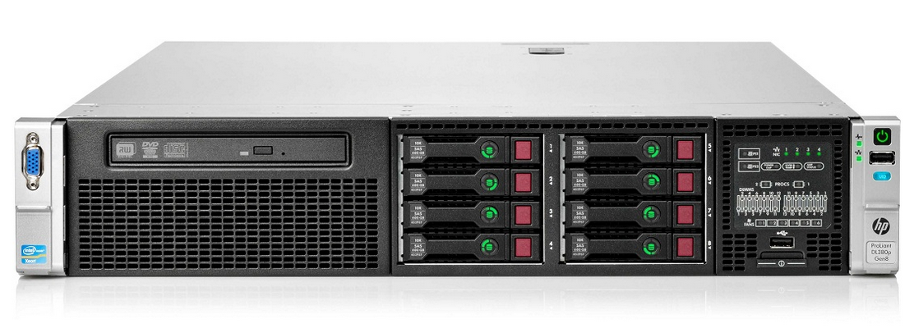
HP ProLiant DL380p G8 SFF
Title
Back To AISS Rack
AISS System

Slide 64
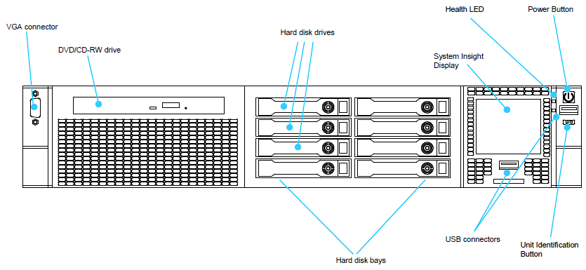
HP ProLiant DL380p G8 SFF
Title
Back To AISS Rack
AISS System

Slide 65
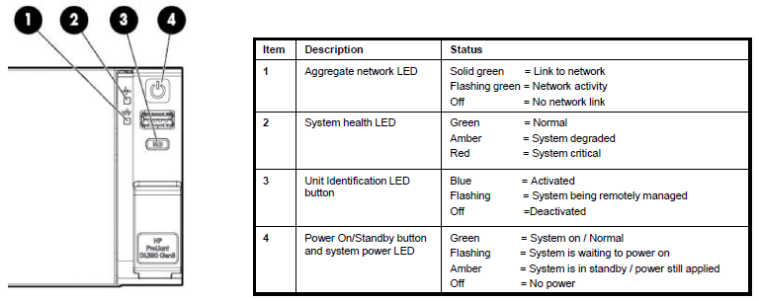
HP ProLiant DL380p G8 SFF
Title
Front panel LEDs and buttons
Back To AISS Rack
AISS System
Notes:
Front panel LEDs and buttons

Slide 66
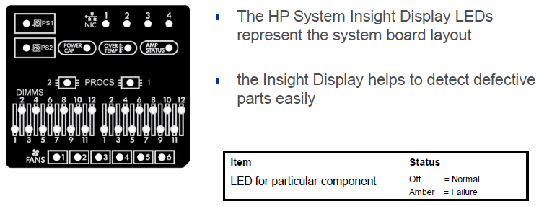
HP ProLiant DL380p G8 SFF
Title
System Insight Display
Back To AISS Rack
AISS System
Notes:
HP ProLiant DL380p Gen8 System Insight Display

Slide 67
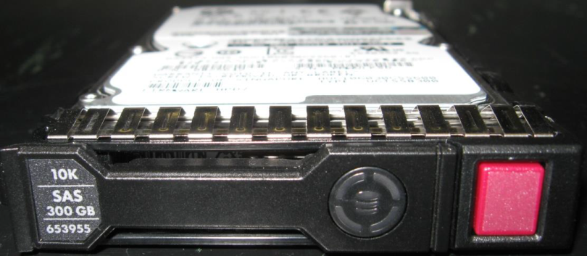
HP ProLiant DL380p G8 SFF
Title
SAS (Serial Attached SCSI) Hard Disk
Capacity :
Speed : 10,000 rpm
Random access time : 4 ms
Transfer rate : 6 Gbps
Interface : 6 Gb/s SAS (Serial Attached SCSI)
Size : SFF, 2.5”, 17.78 x 11.76 cm (W x H)
Hot-swappable
Back To AISS Rack
AISS System

Slide 68
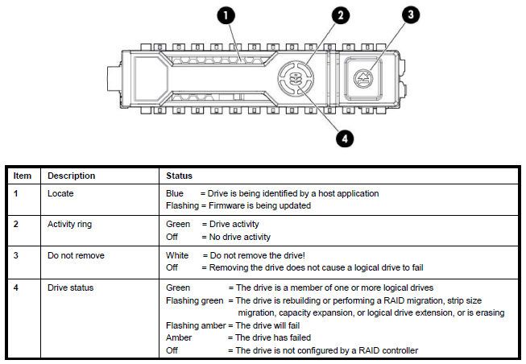
HP ProLiant DL380p G8 SFF
Title
SAS (Serial Attached SCSI) Hard Disk LEDs
Back To AISS Rack
AISS System
Notes:
Capacity :
Speed : 10,000 rpm
Random access time : 4 ms
Transfer rate : 6 Gbps
Interface : 6 Gb/s SAS (Serial Attached SCSI)
Size : SFF, 2.5”, 17.78 x 11.76 cm (W x H)
Hot-swappable

Slide 69
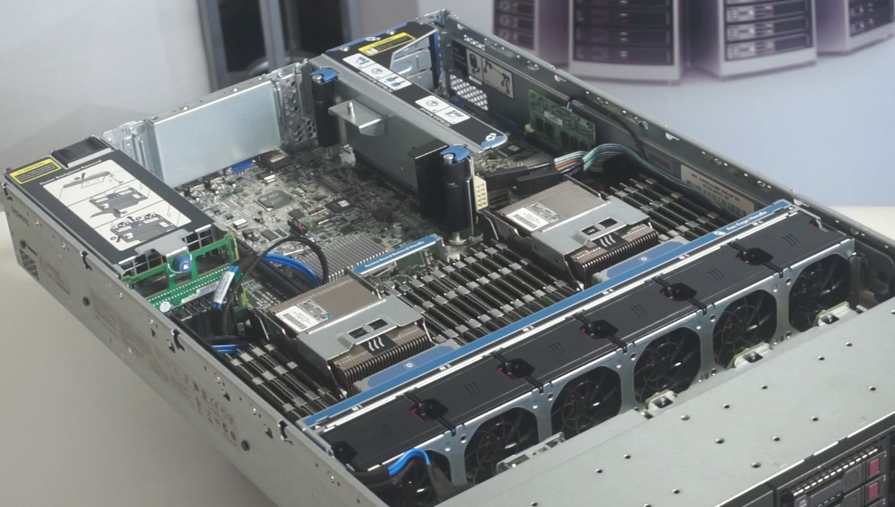
HP ProLiant DL380p G8 SFF
Title
Back To AISS Rack
AISS System

Slide 70
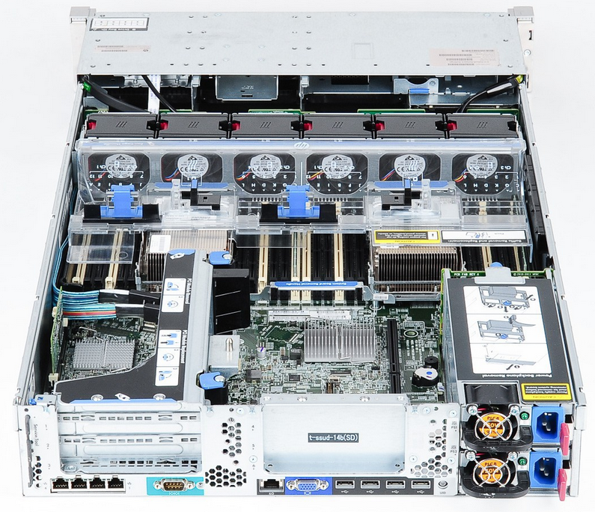
HP ProLiant DL380p G8 SFF
Title
Back To AISS Rack
AISS System

Slide 71
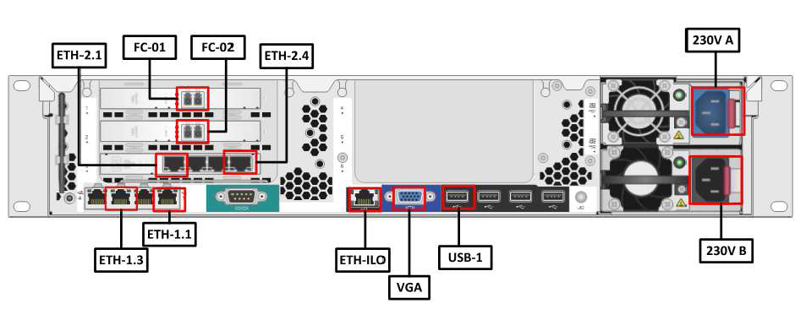
HP ProLiant DL380p G8 SFF
Title
Back To AISS Rack
AISS System
Notes:
Fibre Channel, or FC, is a high-speed network technology (commonly running at 1, 2, 4, 8, 16, 32, and 128 gigabit per
second rates) primarily used to connect computer data storage to servers. Fibre Channel is mainly used in storage
area networks (SAN) in commercial data centers. Fibre Channel networks form a switched fabric because they operate in
unison as one big switch. Fibre Channel typically runs on optical fiber cables within and between data centers.
FlexibleLOM ports (Shown: 4 ports 1Gb each /Optional: 2ports 10Gb each)

Slide 72
HP ProLiant DL380p G8 SFF
Title
Item | Specification
Processors (Dual) | Intel Xeon E5-2600 v2 series
Memory (installed) | 256 GB
Memory Slots | 24 DIMM slots: DDR3 Registered (RDIMM), Load Reduced (LRDIMM), or Unbuffered (UDIMM) memory
Chipset | Intel C600 Series Chipset Intel E5-2600 and E5-2600 v2 Processor Families
On System Management Chipset | HP iLO (Firmware: HP iLO 4) NOTE: For more information, visit: http://www.hp.com/go/ilo
Expansion Slots | PCIe 3.0 Slots 1, 2, 3-PCIe 2.0 top to bottom PCIe 3.0 Slots 4-6 top to bottom
Maximum Internal Storage | 30TB Hot Plug SFF SAS
Back To AISS Rack
AISS System

Slide 73
Back To AISS Rack

Slide 74
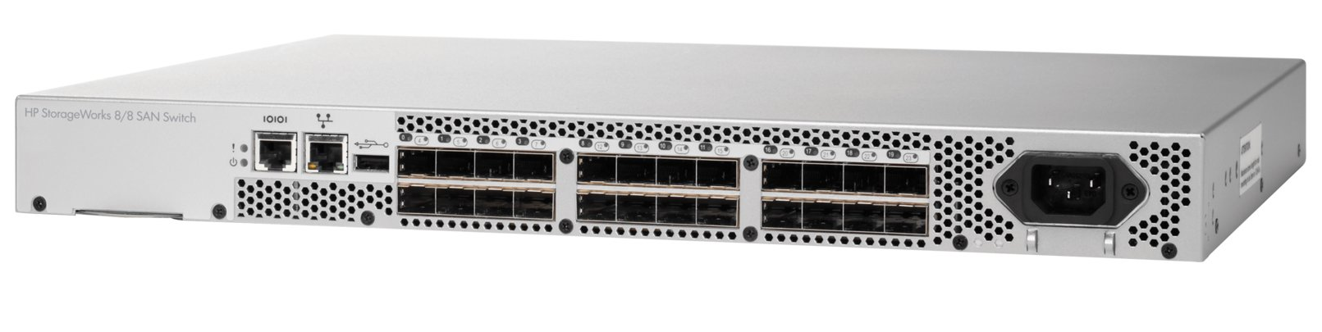
HP 8/8 (8)-Ports Enabled SAN Switch
Title
Back To AISS Rack
AISS System
Notes:
Check if 8-port or 24-port..
2 SAN Switches
HP 8/8 (8)-Ports Enabled SAN Switch
(MAN-SSW-01 & 02)

Slide 75
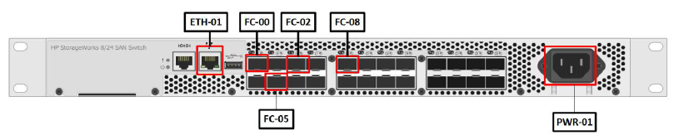
HP 8/8 (8)-Ports Enabled SAN Switch
Title
Back To AISS Rack
AISS System
Notes:
Check if 8-port or 24-port..
2 SAN Switches
HP 8/8 (8)-Ports Enabled SAN Switch
(MAN-SSW-01 & 02)

Slide 76
Back To AISS Rack

Slide 77
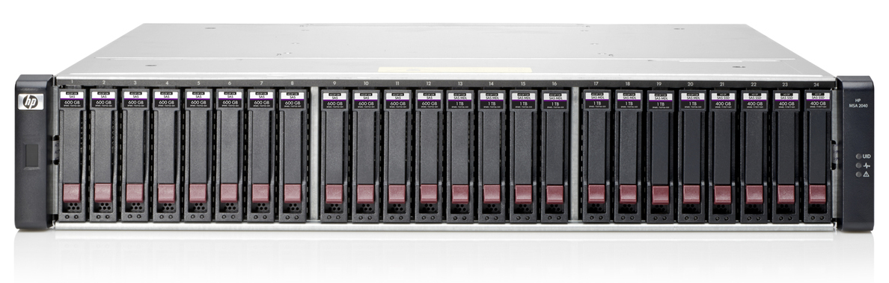
HP MSA P2040 SFF SAN Storage
Title
Back To AISS Rack
AISS System
Notes:
All data and applications on the smartAIM servers and the servers themselves are stored on the SAN. The local disks of the physical servers are only used for the VMware operating system.
The connection to the storage is provided via fibre channel.
A storage area network (SAN)[1] is a network which provides access to consolidated, block level data storage. SANs are
primarily used to enhance storage devices, such as disk arrays, tape libraries, and optical jukeboxes, accessible to servers
so that the devices appear to the operating system as locally attached devices. A SAN typically has its own network of
storage devices that are generally not accessible through the local area network (LAN) by other devices. The cost and
complexity of SANs dropped in the early 2000s to levels allowing wider adoption across both enterprise and small to
medium-sized business environments.
A SAN does not provide file abstraction, only block-level operations. However, file systems built on top of SANs do
provide file-level access, and are known as shared-disk file system

Slide 78
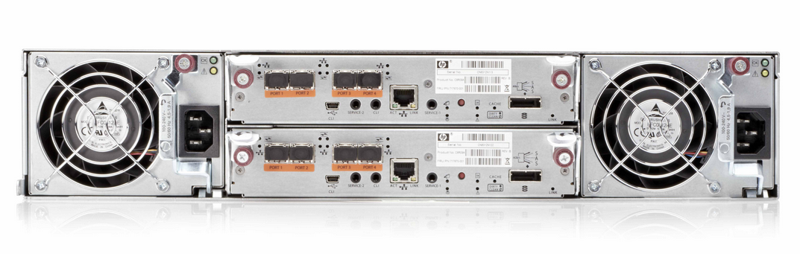
HP MSA P2040 SFF SAN Storage
Title
Back To AISS Rack
AISS System
Notes:
All data and applications on the smartAIM servers and the servers themselves are stored on the SAN. The local disks of the physical servers are only used for the VMware operating system.
The connection to the storage is provided via fibre channel.

Slide 79
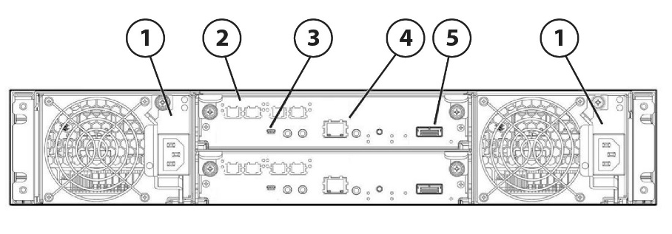
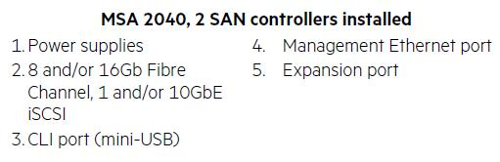
HP MSA P2040 SFF SAN Storage
Title
Back To AISS Rack
AISS System

Slide 80
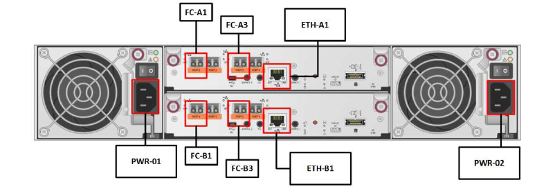
HP MSA P2040 SFF SAN Storage
Title
Back To AISS Rack
AISS System
Notes:
All data and applications on the smartAIM servers and the servers themselves are stored on the SAN. The local disks of the physical servers are only used for the VMware operating system.
The connection to the storage is provided via fibre channel.

Slide 81
Back To AISS Rack

Slide 82
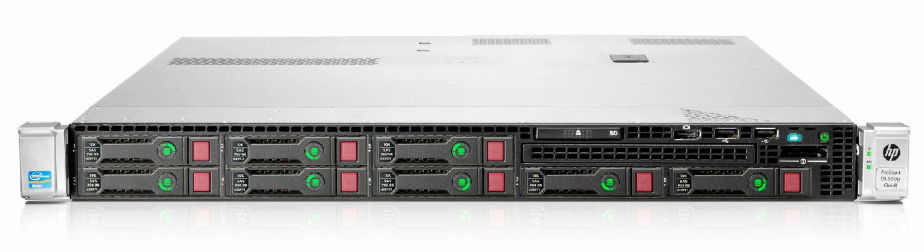
HP ProLiant DL360p G8 SFF
Title
Back To AISS Rack
AISS System
Notes:
A backup refers to the copying and archiving of computer data so it may be used to restore the original.
HP Data Protector – Backup software/tool used.
Full Backup - A repository of this type contains complete system images from one or more specific points in time.
Incremental Backup - An incremental style repository aims to make it more feasible to store backups from more points in time by organizing the data into increments of change between points in time.
Differential Backup - Each differential backup saves the data that has changed since the last full backup.

Slide 83
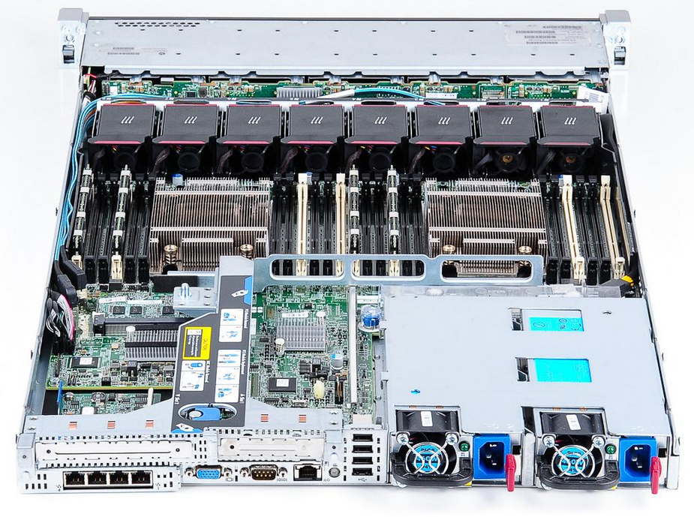
HP ProLiant DL360p G8 SFF
Title
Back To AISS Rack
AISS System
Notes:
A backup refers to the copying and archiving of computer data so it may be used to restore the original.
HP Data Protector – Backup software/tool used.
Full Backup - A repository of this type contains complete system images from one or more specific points in time.
Incremental Backup - An incremental style repository aims to make it more feasible to store backups from more points in time by organizing the data into increments of change between points in time.
Differential Backup - Each differential backup saves the data that has changed since the last full backup.

Slide 84
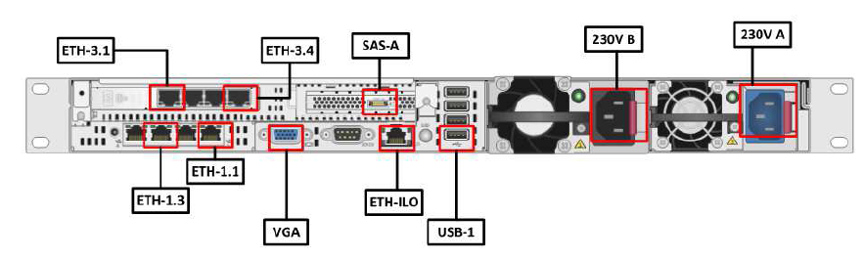
HP ProLiant DL360p G8 SFF
Title
Back To AISS Rack
AISS System
Notes:
A backup refers to the copying and archiving of computer data so it may be used to restore the original.
HP Data Protector – Backup software/tool used.
Full Backup - A repository of this type contains complete system images from one or more specific points in time.
Incremental Backup - An incremental style repository aims to make it more feasible to store backups from more points in time by organizing the data into increments of change between points in time.
Differential Backup - Each differential backup saves the data that has changed since the last full backup.
In computing, Serial Attached SCSI (SAS) is a point-to-point serial protocol that
moves data to and from computer-storage devices such as hard drives and tape drives.
SAS replaces the older Parallel SCSI (Parallel Small Computer System Interface,
usually pronounced "scuzzy" or "sexy"[2]) bus technology that first appeared in the
mid-1980s.
SAS-1: 3 Gbit/s (2005)
SAS-2: 6 Gbit/s (2009)
SAS-3: 12 Gbit/s (2013)
SAS-4: 24 Gbit/s (2017)

Slide 85
Back To AISS Rack

Slide 86
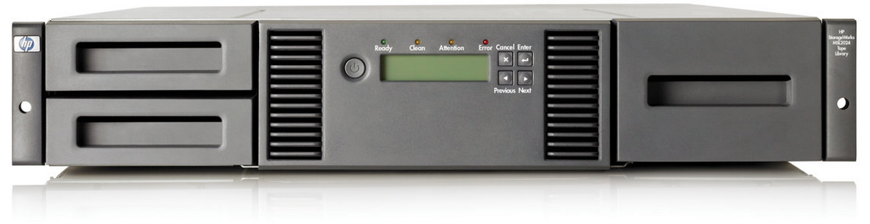
HP MSL 2024 – Tape Library
Title
Back To AISS Rack
AISS System

Slide 87
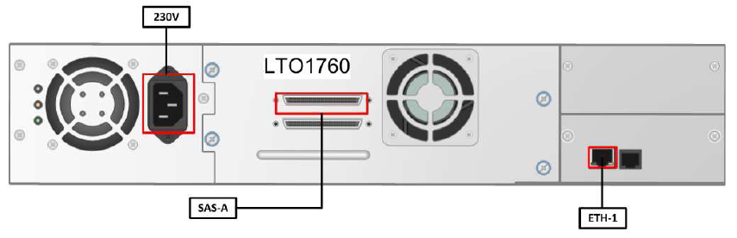
HP MSL 2024 – Tape Library
Title
Back To AISS Rack
AISS System
Notes:
Verify if Fibre Channel or SAS..

Slide 88
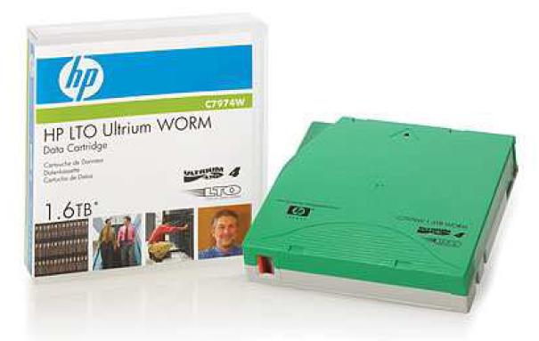
HP LTO-4 Ultrium Tape
Title
Back To AISS Rack
AISS System

Slide 89
Back To AISS Rack

Slide 90
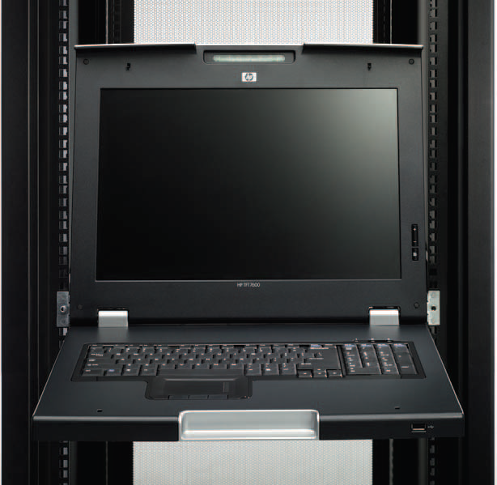
HP TFT7600 US G2 KVM Console
Title
Back To AISS Rack
AISS System
Notes:
(a console represents one keyboard, video monitor, and mouse (KVM) attached to a server)
Designed for rack mount use, the HP TFT7600 US G2 KVM Console is ideal for datacenters, corporate computer rooms and even SMB installations where local access to servers is needed at the rack.
Designed to work with a variety of KVM Switches.

Slide 91
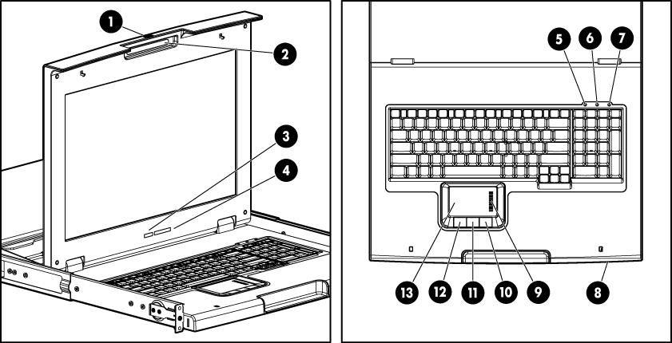
HP TFT7600 US G2 KVM Console
Title
Back To AISS Rack
AISS System

Slide 92
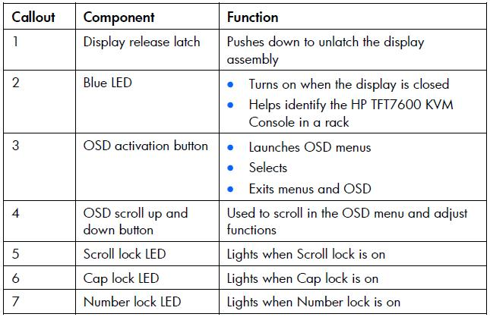
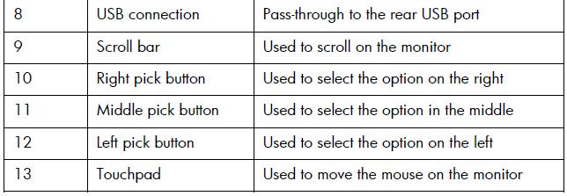
HP TFT7600 US G2 KVM Console
Title
Back To AISS Rack
AISS System
Notes:
OSD – On-screen Display
The OSD buttons are used to operate the HP TFT7600 KVM Console OSD menus.
The OSD menu provides access to display settings and functions, enabling the user to customize the HP TFT7600 KVM Console display settings. (Brightness, Contrast, Image Control – Horizontal and Vertical, Language, Factory Settings, etc..)

Slide 93
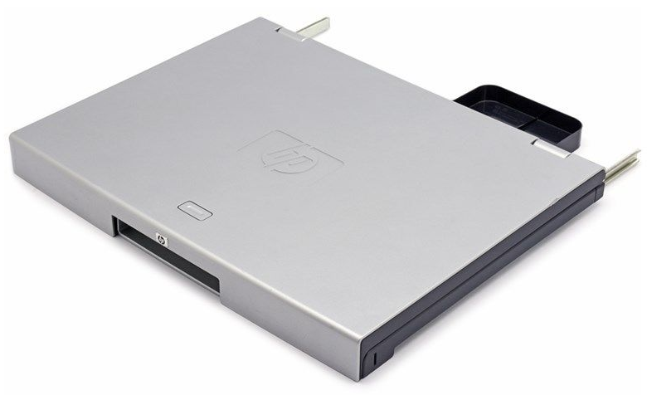
HP TFT7600 US G2 KVM Console
Title
Back To AISS Rack
AISS System

Slide 94
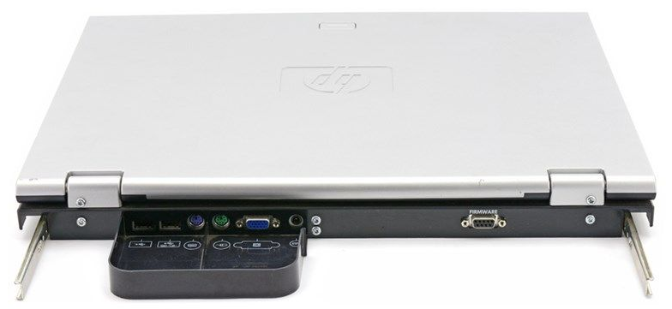
HP TFT7600 US G2 KVM Console
Title
Back To AISS Rack
AISS System

Slide 95


HP TFT7600 US G2 KVM Console
Title
Back To AISS Rack
AISS System

Slide 96

HP TFT7600 US G2 KVM Console
Title
12Vdc
Back To AISS Rack
AISS System
Notes:
Use either the PS/2 cables or USB keyboard/mouse cable when connecting the unit to a device. Do not use both.

Slide 97
HP TFT7600 US G2 KVM Console
Title
Item | Specification
Display Size | 43.9cm (17.3 inch)
Display Type | Flat panel, color-active matrix TFT LCD
Maximum Weight (unpacked) | 4.5 Kg (10 lb)
Resolution | 640 x 480 (VGA) through 1280 x 1024 (SXGA), 1440 x 900 (WXGA+)(recommended), and 1600 x 900 (WXGA+)
Monitor Input | Standard VGA connector
Connectivity | PS2 and USB
Pointing Device | Three-button touchpad with scroll bar
Power Supply | 12 Vdc/36 W
Rack Space | 1U
Back To AISS Rack
AISS System
Notes:
1U = 1.75 inches or 44.45 cm

Slide 98
Back To AISS Rack

Slide 99

HP 0x2x8 KVM Switch
Title
Back To AISS Rack
AISS System
Notes:
HP Server Console Switches are key components for rack mount implementations (a console represents one keyboard, video monitor, and mouse (KVM) attached to a server). The family of HP Server Console Switches allows multiple servers in a rack to be accessed and managed by one keyboard, monitor, and mouse. By using a console switch, as many as 256 computers running different operating systems can be managed. The 8-Port and 16-port Server Console Switches feature an On-Screen Display (OSD) interface, which has intuitive menus for accessing each attached computer or serial attached device. Equipment can be identified by a user-defined name or sequentially by number, enabling easy access.
HP Server Console Switches can be connected in a tiered fashion, to increase server access from eight servers to as many as 256 servers. Switching between computers is accomplished by typing a switching command at the keyboard, or by using the mouse to interact with the graphic interface of the selected computer via the OSD.
The HP Server Console Switch family of products is available in 8- and 16-Port versions. Both versions offers dual console support, allowing the flexibility of controlling switch configurations from more than one location, or by more than one user. Standard rack mounting of the HP Server Console Switches will take up 1U (1.75") of front panel rack space. However, the Switches can also be mounted in a "zero U" profile by mounting in the side rails of the rack, or behind the HP 1U Keyboard Drawer or the 1U TFT7600 Keyboard/monitor drawer.

Slide 100

HP 0x2x8 KVM Switch
Title
Back To AISS Rack
AISS System

Slide 101


HP 0x2x8 KVM Switch
Title
Back To AISS Rack
AISS System

Slide 102

HP 0x2x8 KVM Switch
Title
Back To AISS Rack
AISS System
Notes:
Target Applications and Markets
Network Administrators, System Administrators, Engineering Managers, Chief Information Officers, and Managers of Information Systems are all among the users who will see benefits from using the HP family of server console switches.
Easy access to multiple servers (any server with PS/2 or USB I/O connection port)
Multi-platform management from one console (Microsoft® Windows®, Novell, UNIX®, Linux etc)
Local control and management of servers HP Server Console
Features
On-Screen Display (OSD) – Displays system-related information on the console monitor, such as selected server name, status, power-up test data and configuration menus.
Programmable Scanning – An evaluation of system performance can be made by sequentially scanning any or all of the
computers in the system. Programmable scanning allows you to determine which computers to include as well as the duration of the connection.
Configuration NVRAM – NVRAM (non-volatile RAM) makes it easy to set configuration information using commands entered
from the keyboard. The NVRAM stores the resulting configuration until a user decision is made to change the information,
even if the unit loses power.
Password Protection – For protection against unauthorized users, the switch box provides a password option for security
purposes.
Switch Firmware Update – The application code of the switch can be quickly and easily updated via FLASH ROM. The port
communications settings are automatically configured to allow direct downloading from the connected computer.
Multiple Space Saving 0U Installation Methods –
Side Mount - Rails are provided for mounting the unit to the side of rack cabinets with side mounting capability.
Rear Rack Mount - HP Console Switches may be mounted behind a HP Integrated Keyboard and Drawer (257054-XXX), the TFT5600 or the TFT7600 rack mounted keyboard and monitor with slide rails provided with the switch.
Support for variety of server connections with Interface Adapters
PS/2
USB
VT 100 serial console support
BladeSystems support via front diagnostics connector
Multi-user console switches
The multi-user server console switch has two user ports for multiple user consoles, and multiple system ports as well (many-to-many). The multi-user console offer expanded flexibility, such as the following scenarios:
Simultaneous control of servers in both the data center and in other remote locations.
If there are multiple network administrators, a multiple console switch allows each of them to access all of the servers in their data center to diagnose problems, all from separate locations.

Slide 103

HP 0x2x8 KVM Switch Connectors
Title
Back To AISS Rack
AISS System
Notes:
May use USB instead of PS/2 interface.

Slide 104

HP 0x2x8 KVM Switch Interconnection
Title
Back To AISS Rack
AISS System
Notes:
May use USB instead of PS/2 interface.
The console switch system has at least one local port (based on the specific model) on the rear panel that enables the user to connect a keyboard, monitor, and mouse to the console switch for direct access.
Use the Main dialog box to view, configure, and control servers in the console switch system.
Accessing the Main dialog box
To access the Main dialog box, choose one of the following default key sequences.
• Print Scrn
• Ctrl + Ctrl
To configure the following additional key sequences, see Accessing the Menu dialog box (on page 24).
• Alt + Alt
• Shift + Shift
Soft switching to a previous server
Press the Print Scrn key, then press the Backspace key. This key combination toggles between the previous and current connection.

Slide 105

HP 0x2x8 KVM Switch Interconnection
Title
Back To AISS Rack
AISS System
Notes:
May use USB instead of PS/2 interface.

Slide 106
Back To AISS Rack

Slide 107

Cisco Catalyst WS-2960G-48TC-L Switch
Title
Back To AISS Rack
AISS System
Notes:
2 Cisco Switches
Cisco Catalyst WS-C2960G-48TC-L Switch
(MAN-SWI-01 & 02)

Slide 108

Cisco Catalyst WS-2960G-48TC-L Switch
Title
Back To AISS Rack
AISS System
Notes:
2 Cisco Switches
Cisco Catalyst WS-C2960G-48TC-L Switch
(MAN-SWI-01 & 02)

Slide 109
Back To AISS Rack

Slide 110

Cisco ASA 5512X Security Plus Firewall
Title
Back To AISS Rack
AISS System
Notes:
2 Cisco Firewalls
Cisco ASA 5512X Security Plus Firewall
(MAN-FWF-01 & 02)

Slide 111

Cisco ASA 5512X Security Plus Firewall
Title
Back To AISS Rack
AISS System
Notes:
2 Cisco Firewalls
Cisco ASA 5512X Security Plus Firewall
(MAN-FWF-01 & 02)

Slide 112
Back To AISS Rack

Slide 113


Cisco Catalyst 3750G 48X 10/100/1000/4FSP
Title
Back To WEB02 Rack
AISS System
Notes:
Cisco Catalyst 3750G 48X 10/100/1000 /4SFP
The small form-factor pluggable (SFP) is a compact, hot-pluggable
optical module transceiver used for both telecommunication and data
communications applications. The form factor and electrical interface are
specified by a multi-source agreement (MSA) under the auspices of the
Small Form Factor Committee.[1] It is a popular industry format jointly
developed and supported by many network component vendors.
An SFP interface on networking hardware provides the device with a
modular interface that the user can easily adapt to various fiber optic and
copper networking standards. SFP transceivers exist supporting SONET,
Gigabit Ethernet, Fibre Channel, and other communications standards.
Due to its smaller size, the SFP has replaced the gigabit interface converter (GBIC) in most applications; the SFP is
sometimes referred to as a Mini-GBIC. In fact, no device with this name has ever been officially defined in the MSAs.

Slide 114
Back To WEB02 Rack

Slide 115

Cisco ASA 5510 Firewall
Title
Installed at Mactan ANF only
Back To AISS Rack
AISS System

Slide 116

Cisco ASA 5510 Firewall
Title
Installed at Mactan ANF only
Back To AISS Rack
AISS System

Slide 118


HP Z230 Tower Workstation
Title
Back To AISS Rack
AISS System

Slide 119
Back To AISS Rack

Slide 120

HP Z30i 30Inch IPS Monitor
Title
Back To AISS Rack
AISS System

Slide 121

HP Z30i 30Inch IPS Monitor
Title
Back To AISS Rack
AISS System

Slide 122
Back To AISS Rack

Slide 123

HP Z22i 21.5Inch IPS Monitor
Title
Back To AISS Rack
AISS System

Slide 124

HP Z22i 21.5Inch IPS Monitor
Title
Back To AISS Rack
AISS System

Slide 125
Back To AISS Rack

Slide 126

HP OfficeJet 7110 Wide Format ePrinter
Title
Back To AISS Rack
AISS System
Notes:
HP OfficeJet7110 Wide Format ePrinter

Slide 127
Back To AISS Rack

Slide 128

Brother MFC-J5910DW MFP A3
Title
Back To AISS Rack
AISS System
Notes:
Brother MFC-J5910DW MFP A3 Color Ink Print Scan

Slide 129
Back To AISS Rack

Slide 130

HP DesignJet T2500 e-Multifunction Printer
Title
Back To AISS Rack
AISS System
Notes:
HP DesignJet T2500 e-Multifunction Printer

Slide 131

HP DesignJet T2500 e-Multifunction Printer
Title
Back To AISS Rack
AISS System
Notes:
HP DesignJet T2500 e-Multifunction Printer

Slide 132
Back To AISS Rack

Slide 133

GTCO CalComp A1 Tablet Digitizer, Drawing Board VI
Title
Back To AISS Rack
AISS System
Notes:
GTCO CalComp A1 Tablet Digitizer, Drawing Board VI

Slide 134

GTCO CalComp A1 Tablet Digitizer, Drawing Board VI
Title
Back To AISS Rack
AISS System
Notes:
GTCO CalComp A1 Tablet Digitizer, Drawing Board VI

Slide 135

GTCO CalComp A1 Tablet Digitizer, Drawing Board VI
Title
Back To AISS Rack
AISS System
Notes:
GTCO CalComp A1 Tablet Digitizer, Drawing Board VI

Slide 136

GTCO CalComp A1 Tablet Digitizer, Drawing Board VI
Title
Back To AISS Rack
AISS System
Notes:
GTCO CalComp A1 Tablet Digitizer, Drawing Board VI

Slide 137

GTCO CalComp A1 Tablet Digitizer, Drawing Board VI
Title
Back To AISS Rack
AISS System
Notes:
GTCO CalComp A1 Tablet Digitizer, Drawing Board VI

Slide 138
Back To AISS Rack

